Slide 1







Slide 2
Programming @ the Speed of Thought
Bezpalyi Kyrylo
Ciklum, MSP.

Slide 3
Motivation
Every compiler is a code generator
We don’t write binary
Or even ASM
Every programmer is a code generator
Code generation = the computer helping us make programs
Typically implies raising the level of abstraction

Slide 4
Why
Language verbosity & lack of suitable constructs
Lack of metaprogramming facilities
Because generating text is (relatively) easy

Slide 5
Snippets
Visual Studio snippets
Predefined chunks of text
Placeholders for parts that need to be filled in
Resharper
More context-aware
Executable macros
Embedded DSL
Mnemonics (pseudo DSL)
Emmet, ZenSharp
Generation completion

Slide 6
Generate menu
Generative snippets can only go so far
Al configuration options must be embedded
Dedicated Generate menu takes things further
Effectively, a mini code generation app inside your IDE

Slide 7
Preprocessor?
.Net does not support preprocessing ☹

Slide 8
T4
Text templating transformation toolkit
Special processing of .tt files
Effectively a text template with build-in C# code
Just like Razor views ☺
Typically produces a single output file
Can be hacked to produce more than one

Slide 9
Using of T4 in web
Swagger
WebApiProxy
NSwag

Slide 10
Swagger (Swashbuckle)
Generate documentation
Know about response codes, errors, authentication, versioning
Use swagger codegen to generate clients or ...

Slide 11
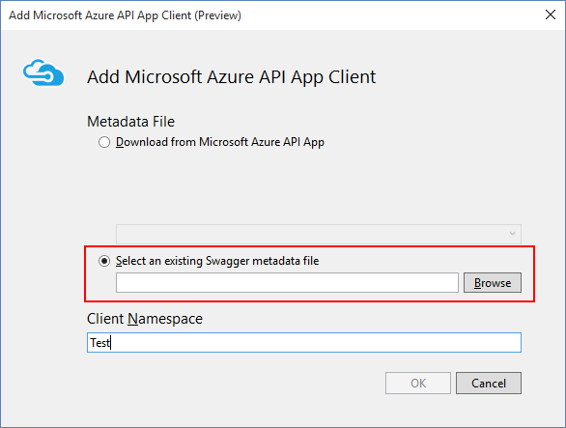
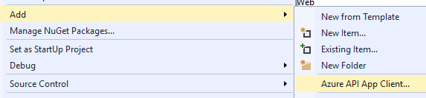
Something new ☺

Slide 12
WebapiProxy
On server:
Install-Package WebApiProxy
For HttpConfiguration: config.RegisterProxyRoutes();
On client (C#):
Install-Package WebApiProxy.Csharp
In spec config: <proxy endpoint="http://myservice.net/api/proxies" />
In console: WebApiProxy-Generate-Csharp
On Client (web):
<script src="/api/proxies" type="text/javascript"></script>

Slide 13
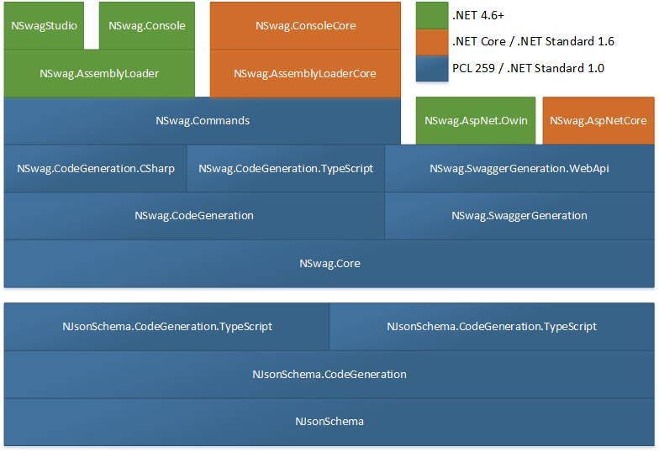
NSWAG

Slide 14
Going Meta
Metaprogramming = executable code that effects AST
Before compilation (C++)
After compilation
PostSharp
During compilation
Metaprogramming-aware languages

Slide 15
Code generation software
Visual Studio, R# (Rider)
General-purpose templating generator (e.g. CodeSmith)
ORM generators (LLBLGen, SqlMetal.exe, etc.)
Domain front-ends (Mathematica, MPS)
Domain transformations (X2C, MathSharp, Blackmire)
Code generation API/REPL

Slide 16
Questions?

